Slide 1

WIKIEDIT A Service for Suggesting Wikipedia Pages to Edit
Gargee Anjikar
Rakesh Deivachilai
Vivek Vijayan
Graduate Students
University of Maryland, Baltimore County
CMSC 668
Fall 2013
December 2nd, 2013

Slide 2
Outline
Introduction
Targeted Users
Related Work
Functional Requirements
BIG Data
Processing the Data
Design
WSDL
SOAP
Computing Services
Front End
Security
Responsibilities
Challenges
Future Enhancements
References

Slide 3

Introduction
WIKIEDIT is a service for suggesting Wikipedia pages to edit.
Pages are suggested to users based on their editing history and Area of Interest.
A simple Web Service is created and each user must register by providing the below details:
Valid Wikipedia User Name
Area of Interest
Email Address

Slide 4
Introduction (2)
All the required Big Data and Data Sets are retrieved from the Wikipedia dumps
The dumps consists of various revisions along with their user names and the titles of the pages they have edited along with the other details.
Along with the help of SQL and Map Reduction, we have retrieved the username and title of the page.

Slide 5
Targeted Users
Enthusiastic Wikipedia Users who have contributed in Wikipedia and wish to make further contributions.

Slide 6
Related Work
SuggestBot
- It is a program that attempts to help Wikipedia users find pages to edit based on their past contributions.
Limitations:
Suggestions are provided based on only edit history and no user centered information is not taken into consideration.

Slide 7
Functional Requirements
User Inputs:
Registering with our System.
Providing their Wikipedia Username, Email Id and Area of Interest.
Processing
Authenticating the Wikipedia Username.
Look up the User’s edit history.
Find pages related to User’s edit history and area of interest.
Output to Users:
Links to Suggested Wikipedia pages to edit.

Slide 8
BIG Data
Wikipedia edit history data
- About 4 TB (compressed)
Wikipedia Revisions in the main namespace
- 400 GB
http://snap.stanford.edu/data/wiki-meta.html
For the Implementation
- First 20 GB of the Revisions Data and 5 GB of DBPedia Dataset.

Slide 9
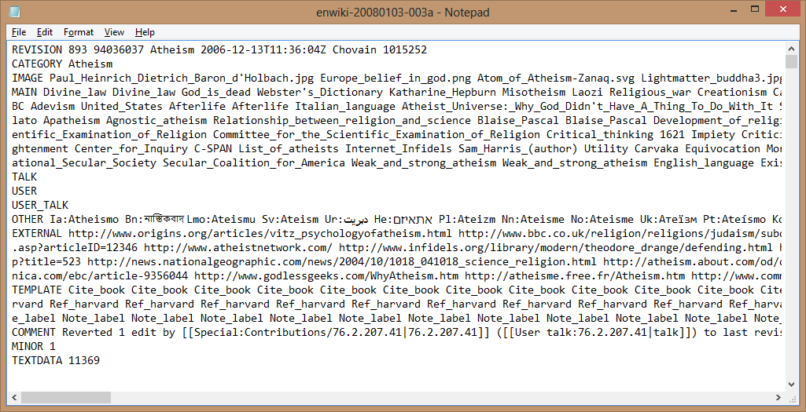
BIG Data (2)

Slide 10
Preprocessing the Data
We have parsed the data using MapReduce and selected only the
username
corresponding title of the article that the user have edited.

Slide 11
MAP - REDUCE
public static void main(String[] args) throws Exception
{ Configuration conf = new Configuration(); String[] otherArgs = new GenericOptionsParser(conf, args).getRemainingArgs(); conf.set("wordtoSearch", "REVISION"); Job job = new Job(conf, "Get Line"); job.setJarByClass(GetLine.class); job.setMapperClass(TokenizerMapper.class); job.setCombinerClass(MyReducer.class); job.setReducerClass(MyReducer.class); job.setOutputKeyClass(Text.class); job.setOutputValueClass(IntWritable.class); FileInputFormat.addInputPath(job, new Path(otherArgs[0])); FileOutputFormat.setOutputPath(job, new Path(otherArgs[1])); System.exit(job.waitForCompletion(true) ? 0 : 1) } }

Slide 12
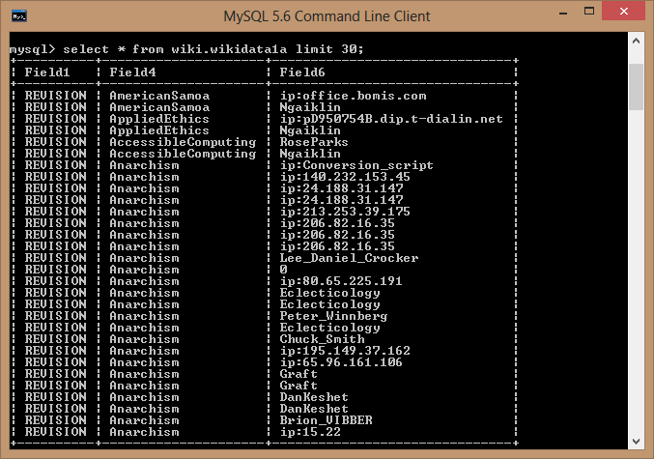
Preprocessed Data in SQL Database

Slide 13
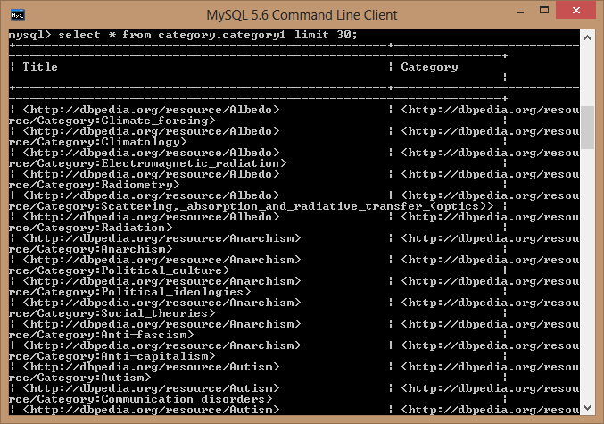
Dbpedia Data Set – Titles and Categories

Slide 14
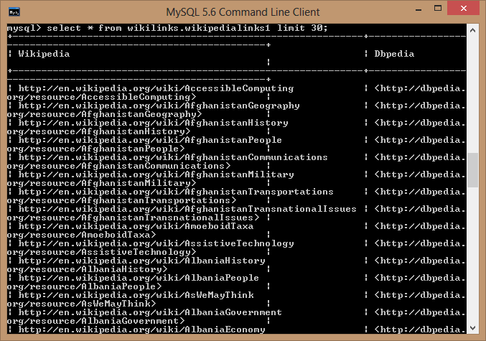
Dbpedia Data Set – Wikipedia Links

Slide 15
Project Design
WIKIEDIT API
HTTP / SOAP
GLASS FISH SERVER
WSDL
MYSQL SYSTEM
QUERIES
USER CREDENTIAL SYSTEM
GET PAGES BASED ON HISTORY
GET PAGES BASED ON USER INTEREST
BLUEGRIT SYSTEM
DBPEDIA DATABASE AND WIKIPEDIA DUMPS

Slide 16
WSDL
<!--
Published by JAX-WS RI at http://jax-ws.dev.java.net. RI's version is Metro/2.3 (tags/2.3-7528; 2013-04-29T19:34:10+0000) JAXWS-RI/2.2.8 JAXWS/2.2 svn-revision#unknown.
-->
<!--
Generated by JAX-WS RI at http://jax-ws.dev.java.net. RI's version is Metro/2.3 (tags/2.3-7528; 2013-04-29T19:34:10+0000) JAXWS-RI/2.2.8 JAXWS/2.2 svn-revision#unknown.
-->
<definitions xmlns:wsu="http://docs.oasis-open.org/wss/2004/01/oasis-200401-wss-wssecurity-utility-1.0.xsd" xmlns:wsp="http://www.w3.org/ns/ws-policy"xmlns:wsp1_2="http://schemas.xmlsoap.org/ws/2004/09/policy" xmlns:wsam="http://www.w3.org/2007/05/addressing/metadata"xmlns:soap="http://schemas.xmlsoap.org/wsdl/soap/" xmlns:tns="http://Wikipedia.org/" xmlns:xsd="http://www.w3.org/2001/XMLSchema"xmlns="http://schemas.xmlsoap.org/wsdl/"

Slide 17
WSDL (2)
targetNamespace="http://Wikipedia.org/" name="wikiSearchService">
<types>
<xsd:schema>
<xsd:import namespace="http://Wikipedia.org/" schemaLocation="http://rakesh-pc:8080/WikiEdit/wikiSearchService?xsd=1"/>
</xsd:schema>
</types>
<message name="wikiFind">
<part name="parameters" element="tns:wikiFind"/>
</message>
<message name="wikiFindResponse">
<part name="parameters" element="tns:wikiFindResponse"/>
</message>
<portType name="wikiSearch">
<operation name="wikiFind">
<input wsam:Action="http://Wikipedia.org/wikiSearch/wikiFindRequest" message="tns:wikiFind"/>
<output wsam:Action="http://Wikipedia.org/wikiSearch/wikiFindResponse" message="tns:wikiFindResponse"/>
</operation>
</portType>

Slide 18
WSDL (3)
<binding name="wikiSearchPortBinding" type="tns:wikiSearch">
<soap:binding transport="http://schemas.xmlsoap.org/soap/http" style="document"/>
<operation name="wikiFind">
<soap:operation soapAction=""/>
<input>
<soap:body use="literal"/>
</input>
<output>
<soap:body use="literal"/>
</output>
</operation>
</binding>
<service name="wikiSearchService">
<port name="wikiSearchPort" binding="tns:wikiSearchPortBinding">
<soap:address location="http://rakesh-pc:8080/WikiEdit/wikiSearchService"/>
</port>
</service>
</definitions>

Slide 19
SOAP - REQUEST
<?xml version="1.0" encoding="UTF-8"?>
<S:Envelope xmlns:S="http://schemas.xmlsoap.org/soap/envelope/" xmlns:SOAP-ENV="http://schemas.xmlsoap.org/soap/envelope/">
<SOAP-ENV:Header/>
<S:Body>
<ns2:wikiFind xmlns:ns2="http://Wikipedia.org/">
<arg0>Mykenism</arg0>
</ns2:wikiFind>
</S:Body>
</S:Envelope>

Slide 20
SOAP – RESPONSE
<?xml version="1.0" encoding="UTF-8"?><S:Envelope xmlns:S="http://schemas.xmlsoap.org/soap/envelope/" xmlns:SOAP-ENV="http://schemas.xmlsoap.org/soap/envelope/">
<SOAP-ENV:Header/>
<S:Body> <ns2:wikiFindResponse xmlns:ns2="http://Wikipedia.org/"> <return>http://en.wikipedia.org/wiki/Individualist_anarchism</return> <return>http://en.wikipedia.org/wiki/Panarchism</return> <return>http://en.wikipedia.org/wiki/Traditional_anarchism</return>
</ns2:wikiFindResponse>
</S:Body>
</S:Envelope>

Slide 21
Computing Services
WSDL
Description of the contract of the web service.
SOAP/XML
Enables the exchange of a structured information in the implementation of web services in a network.
Glass Fish
XML-based web service framework which is used to expose web services by generating WSDLs.
BlueGrit
Enables data processing by providing a cloud-computing framework.

Slide 22
Computing Services (2)
Wikipedia Dumps
Dumps (text format) provided by Wikimedia Foundation.
Revisions in the main namespace.
MYSQL
Open source RDBMS used to store and access tables from the Wikipedia dumps.
Java
Used to provide the framework of the service.
Connecting with the MYSQL database.

Slide 23
Front End – Login
The front page consists of
A short description of the service.
User login
Registration button

Slide 24
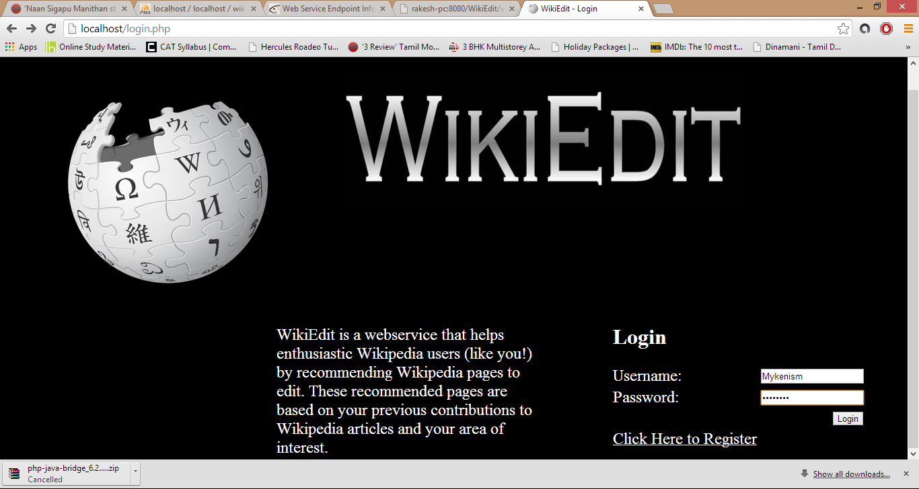
Front End – Login

Slide 25
Front End – Registration
The registration page consists of fields that accept
Wikipedia username
Email ID
Password
Area of interest

Slide 26
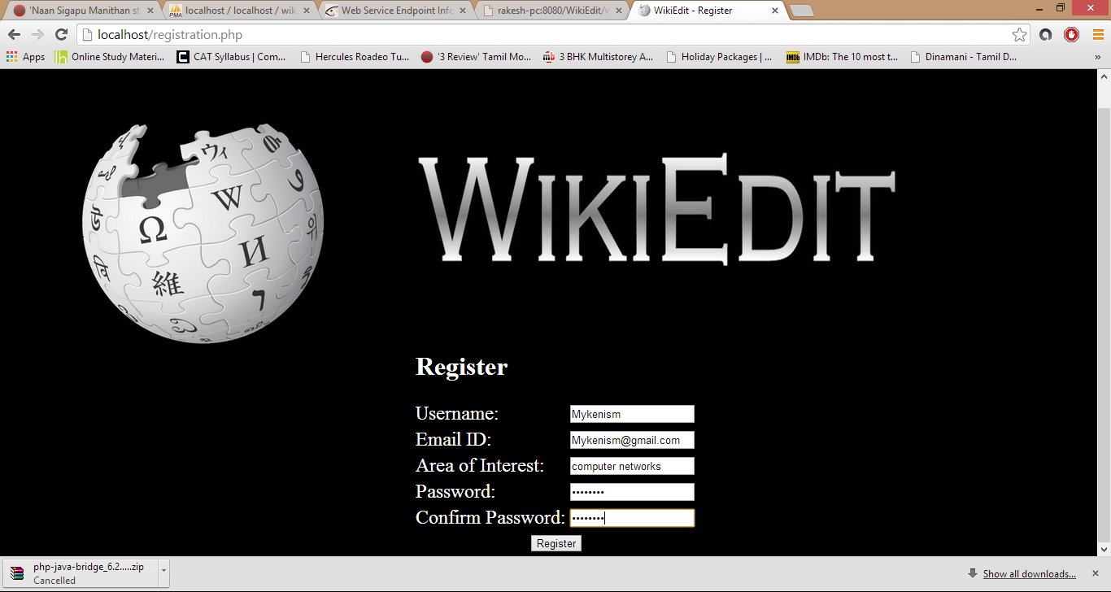
Front End – Registration

Slide 27
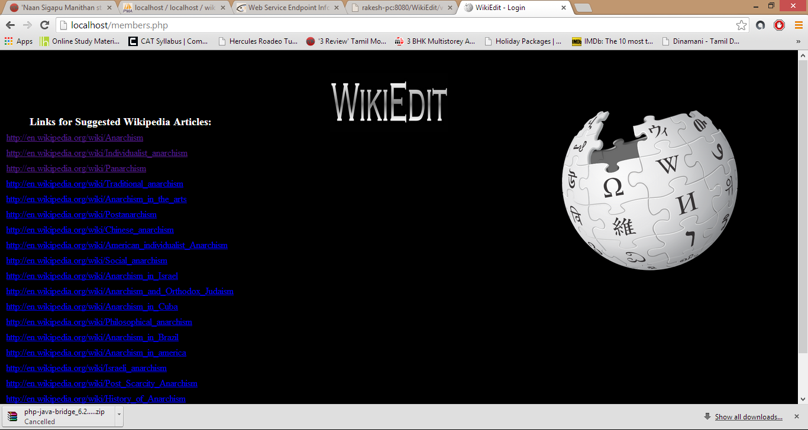
List of Links to Suggested Articles

Slide 28
Security
User Login and Authentication
Encrypting the user password with MD5 while storing in the database.
Validating Wikipedia User ID

Slide 29
Responsibilities
Combined Responsibilities
Final Paper and Presentation
Testing the Web Service
Gargee
User Interface Design including creating HTML web page, Authentication System and WSDL.
Rakesh
Working with Big Data, preprocessing it and importing it to MYSQL database.
Vivek
Integrating the front end with DBPedia and filtering the outgoing links from DBPedia based on the User’s Area of Interest and also handling the further interactions between the systems to provide the required service.

Slide 30
Challenges
Implementing MapReduce to preprocess the data.
Extracting username, title and the category of the page from the dumps.
Implementing the entire project by the deadline.

Slide 31
Future Enhancements
Location
Suggestions based on location
Socializing
Provide groups where users get to meet people who have edited the same types of pages.
Provide a provision in the groups where users get to see the pages that other user’s have edited.

Slide 32
References
Auer, Bizer, Kobi, Larov, Lehmann, Cyganiak, Ives.“DBPedia: A Nucleus for a Web of Open Data” http://www.cis.upenn.edu/~zives/research/dbpedia.pdf
Mendes, Jakobi, Garcia-Silva, Bizer. “DBPedia Spotlight: Shedding Light on the Web of Documents”
http://www.wiwiss.fuberlin.de/en/institute/pwo/bizer/research/publications/Mendes-Jakob-GarciaSilva-Bizer-DBpediaSpotlight-ISEM2011.pdf
http://dbpedia.org/About
http://en.wikipedia.org/wiki/User:SuggestBot
http://www.w3schools.com/

Slide 33
THANK YOU!!
QUESTIONS??

